Slide 1
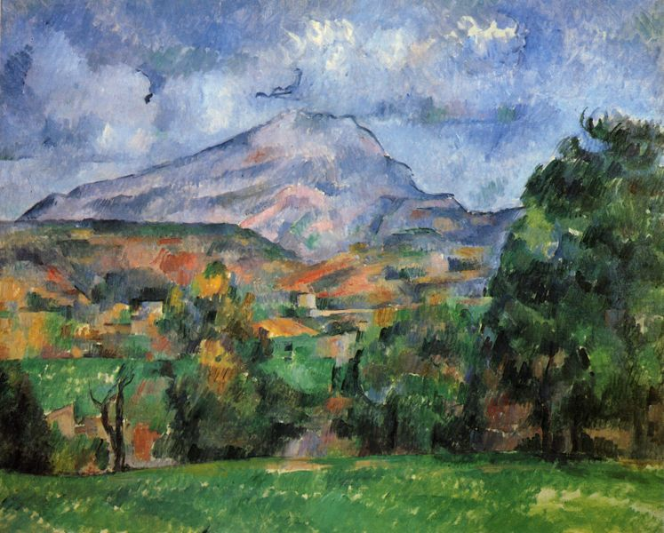
The Birth of Modern Art
Paul Cezanne Montagne Saint-Victoire 1888-1890

Slide 2
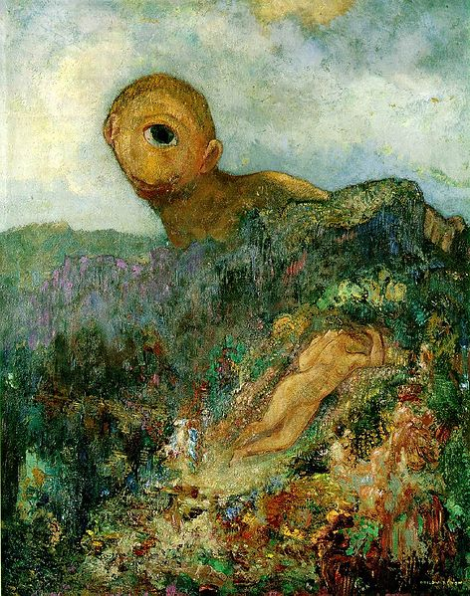
SYMBOLISM
Cyclops
Odilon Redon
1914

Slide 3
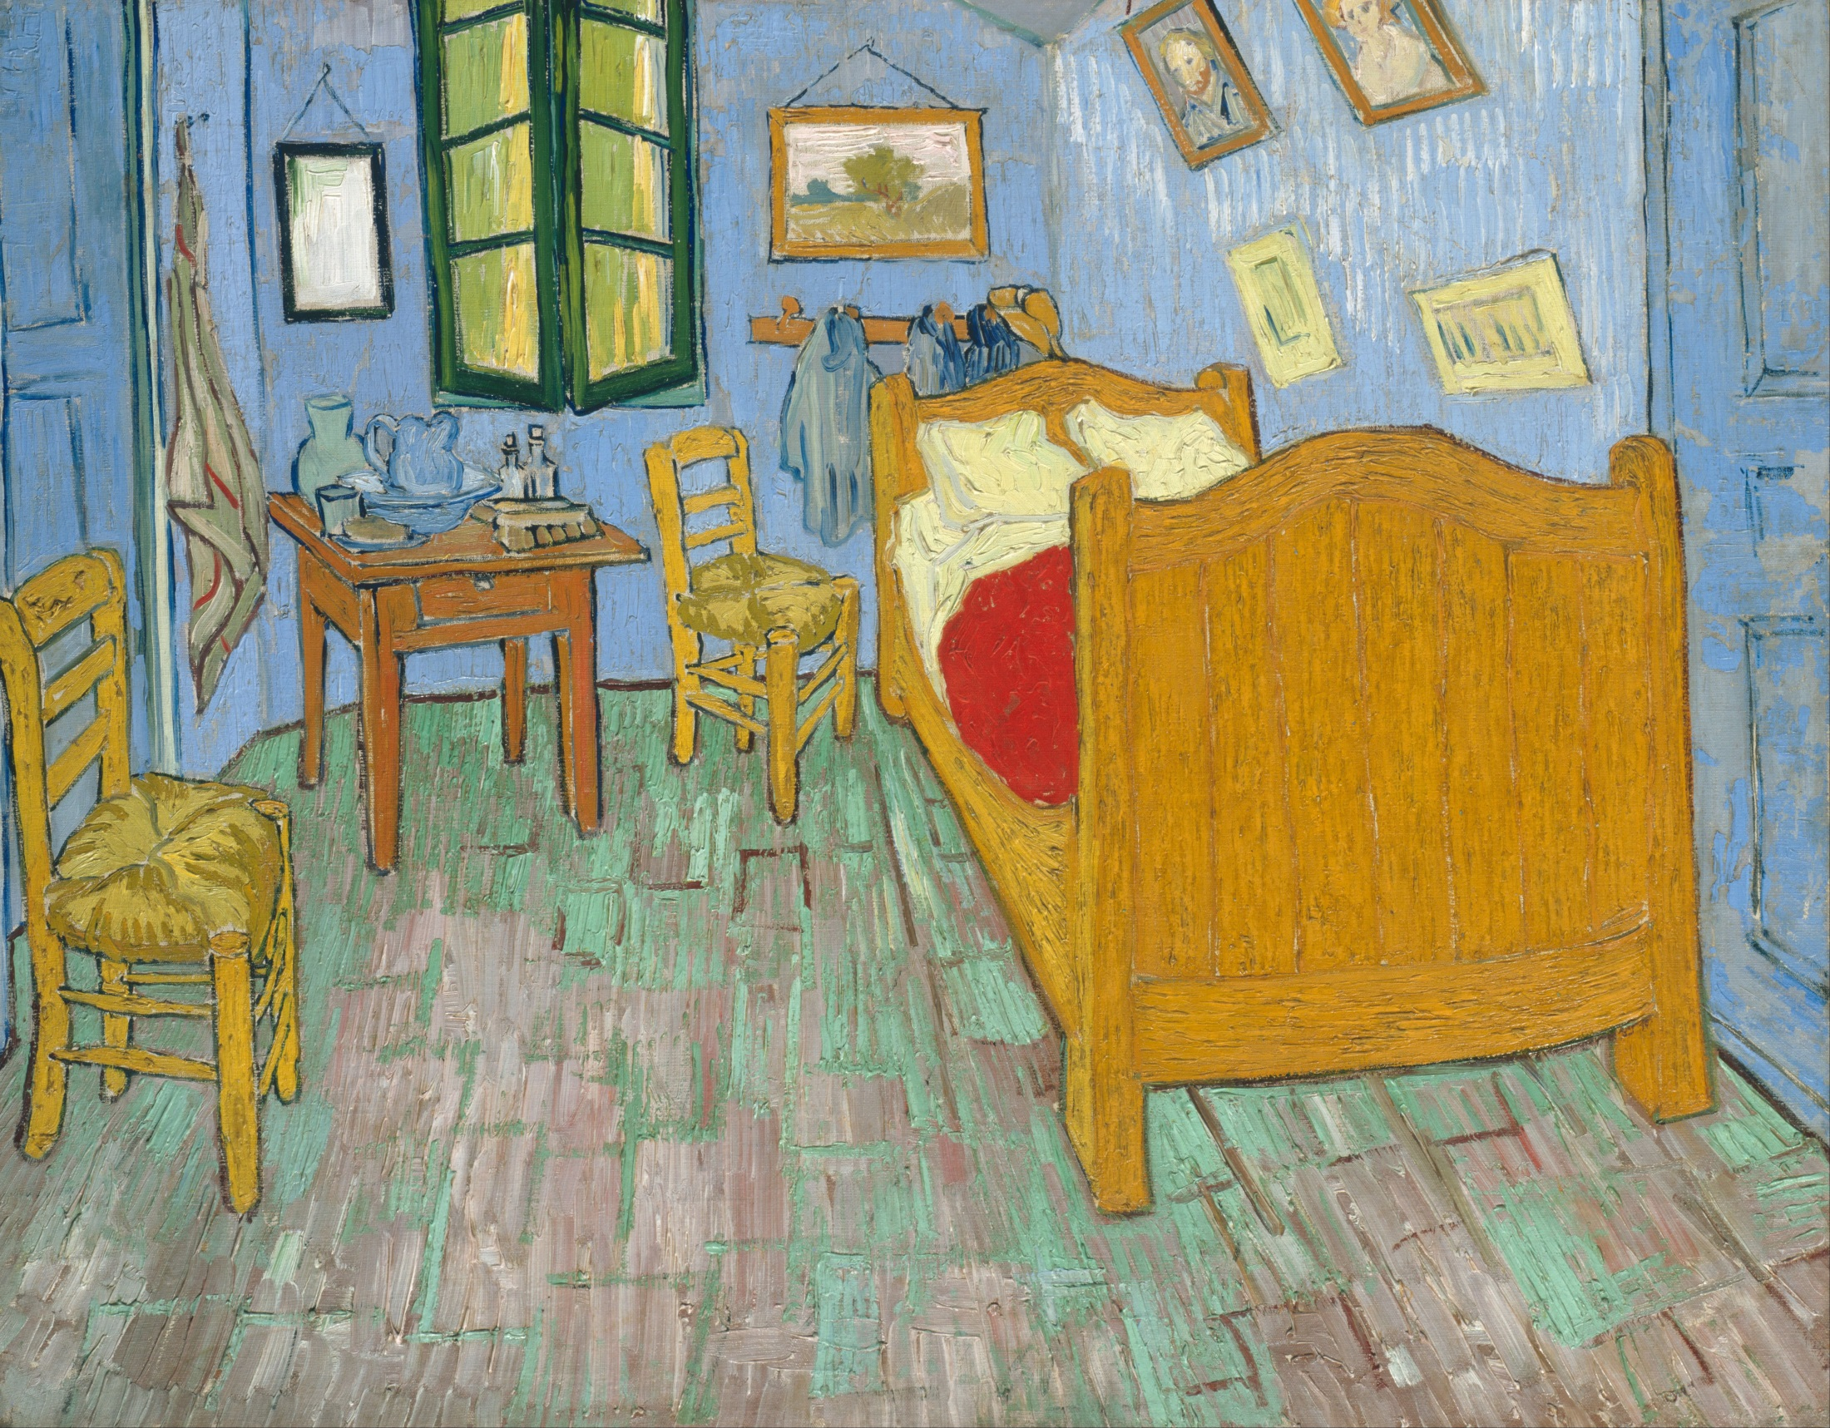
Post Impressionism
Vincent Van Gogh
The Bedroom
1889

Slide 4
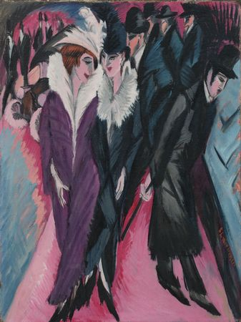
German Expressionism
Die Brucke
(The Bridge)
Edwin Ludwig Kirchner
Street Scene, Berlin
1913

Slide 5
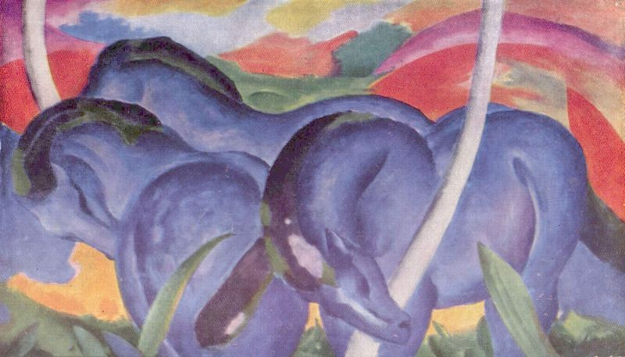
German Expressionism
Ber Blaue Reiter (The Blue Rider)
Franz Marc
Large Blue Horses
1911

Slide 6
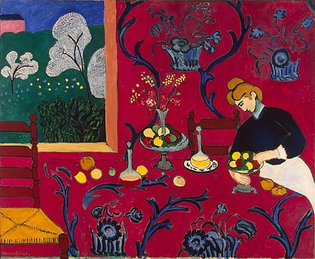
Fauvism
Henri Matisse
The Dessert: Harmony in Red
1908

Slide 7
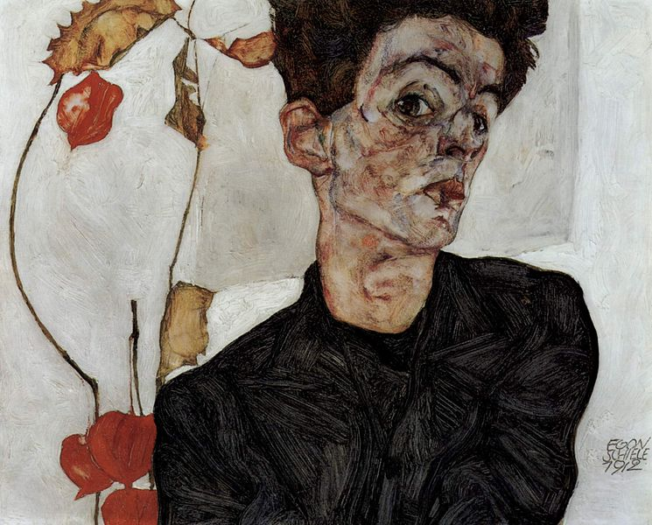
Austrian Expressionism
Egon Schiele
Self Portrait
1912

Slide 8
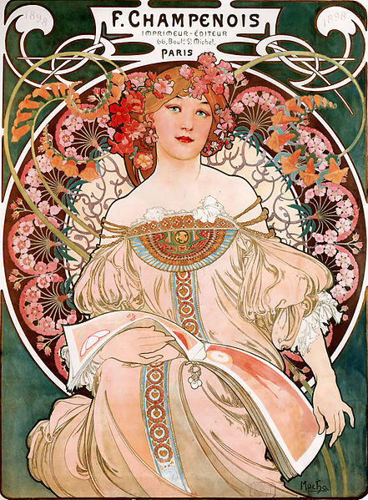
Art Nouveau
Alfons Mucha
F. Champenois: Imprmieur Editeur
1897

Slide 9
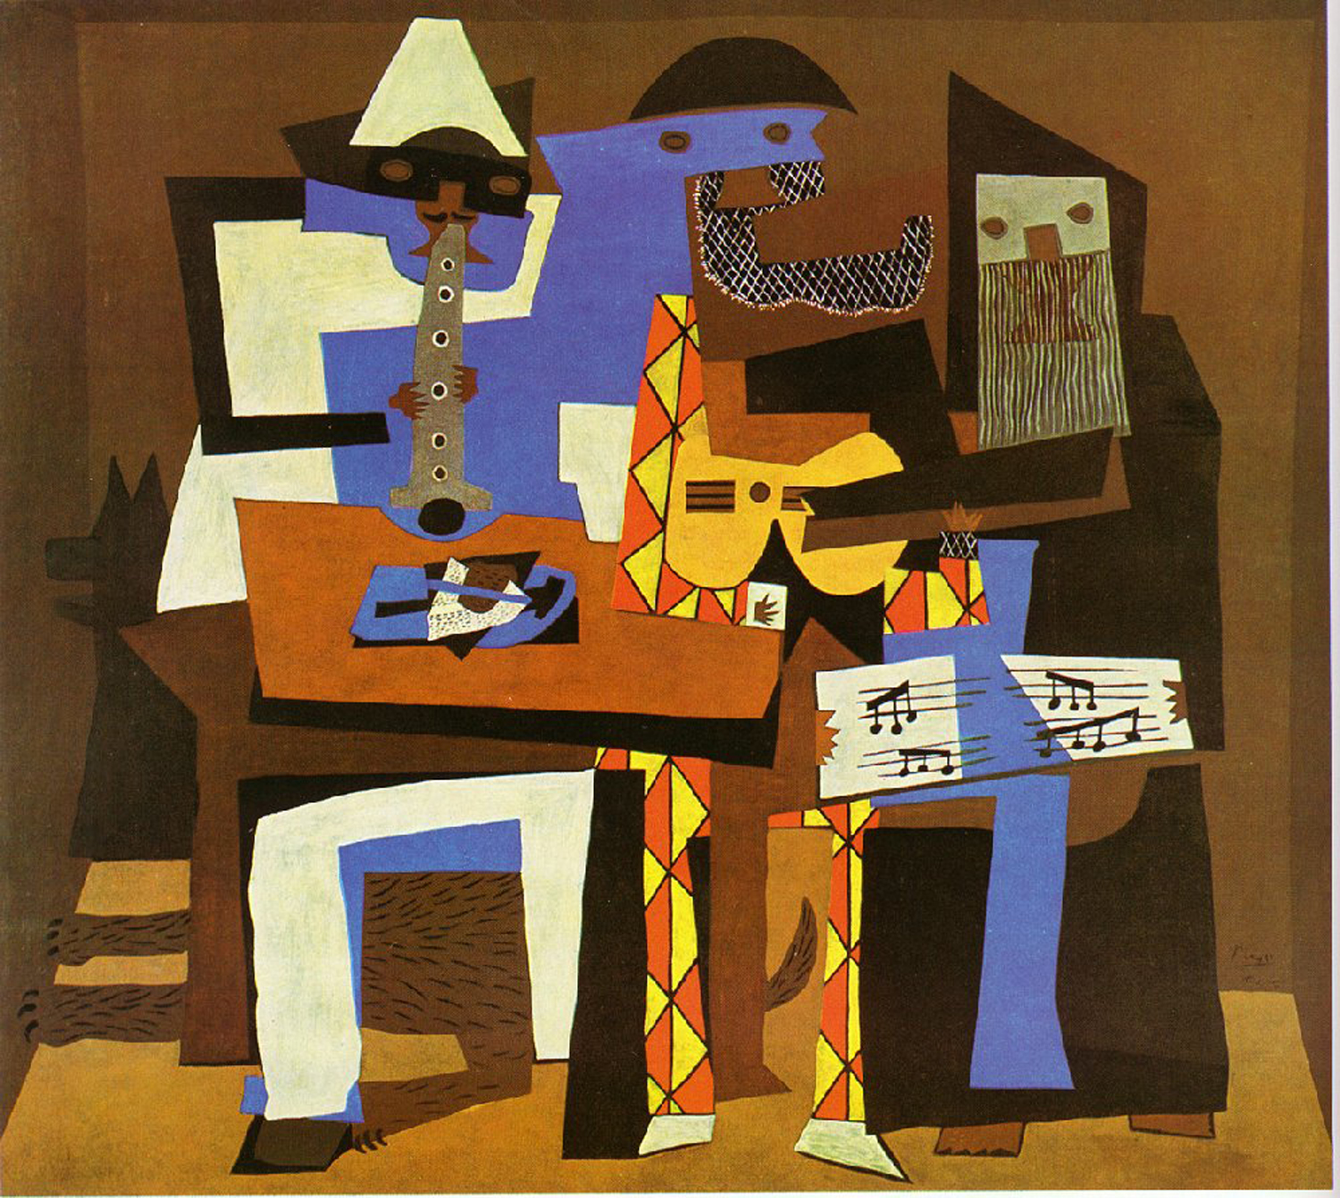
Cubism
Pablo Picasso
The Three Musicians 1921

Slide 10
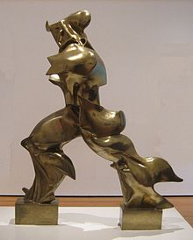
Futurism
Umberto Boccioni,
Unique Forms of Continuity in Space (1913)
Suprematism
Suprematist Composition- White on White (Malevich, 1918)

Slide 11
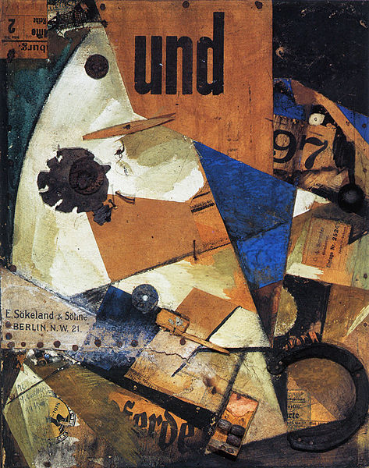
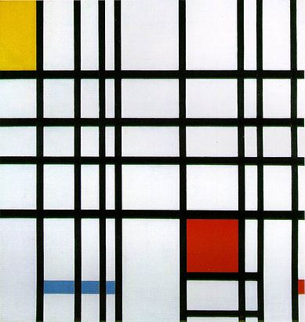
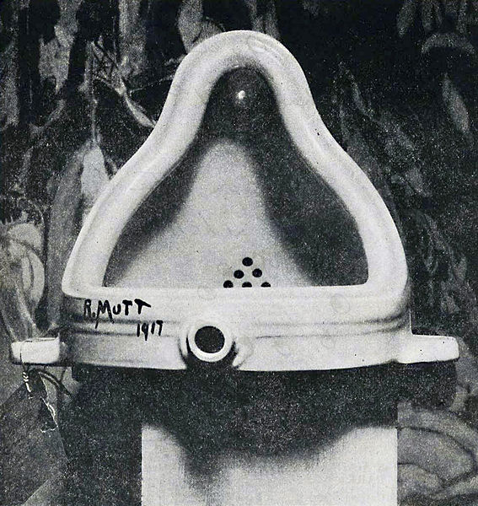
De Stijl
Composition with Yellow,
Blue, and Red, 1937–42, Piet Mondrian
Constructivism
Kurt Schwitters
Das Undbild, 1919,
Dada
Fountain
1917, Marcel Duchamp

Slide 12
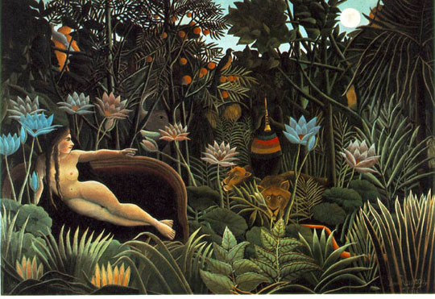
Fantastic Art
Henri Rousseau
The Dream
1910

Slide 13
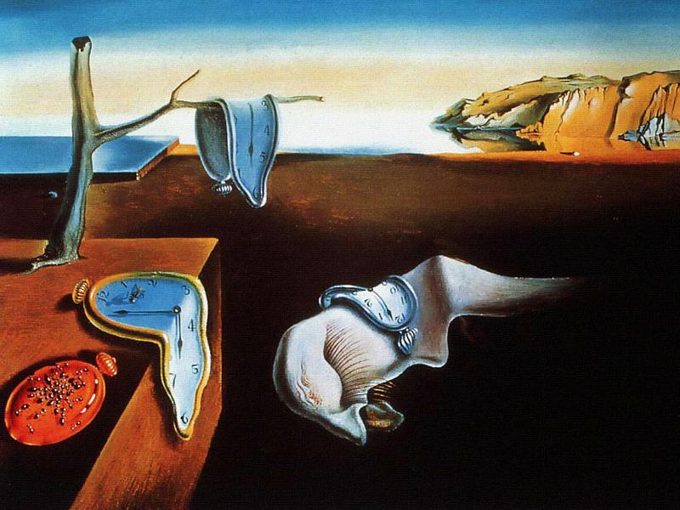
Surrealism
Salvador Dali
The Persistence of Memory
1931

Slide 14
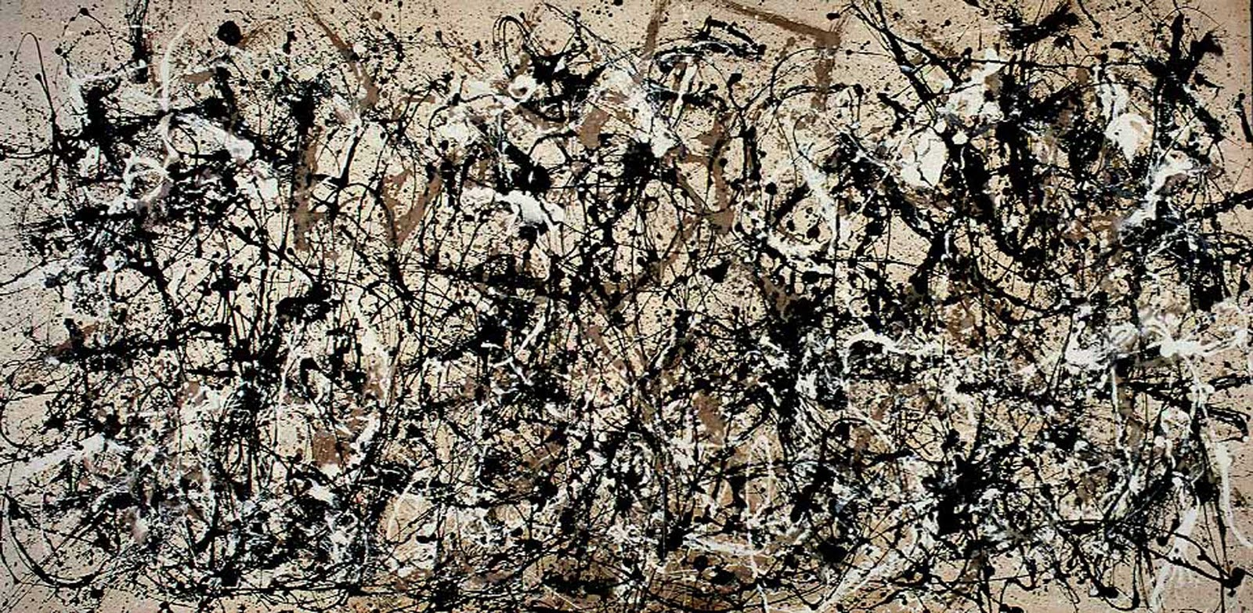
Abstract Expressionism
Jackson Pollock
Autumn Rhythm #30
1930

Slide 15
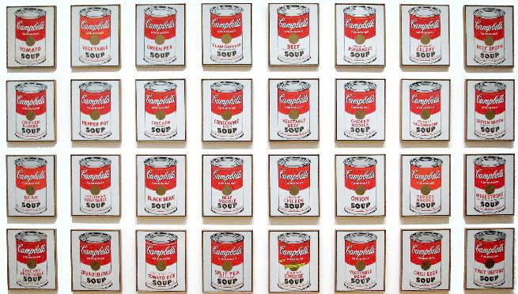
Pop Art
Andy Warhol
Campbell’s Soup Cans
1962

Slide 16
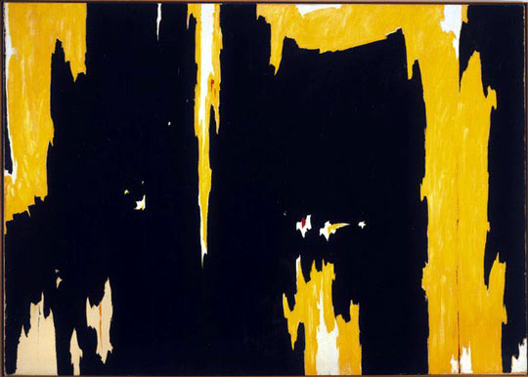
Color Field
Clyfford Still
1957 D1
1957

Slide 17
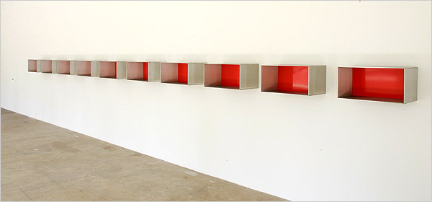
Minimalism
Donald Judd
1974

Slide 18
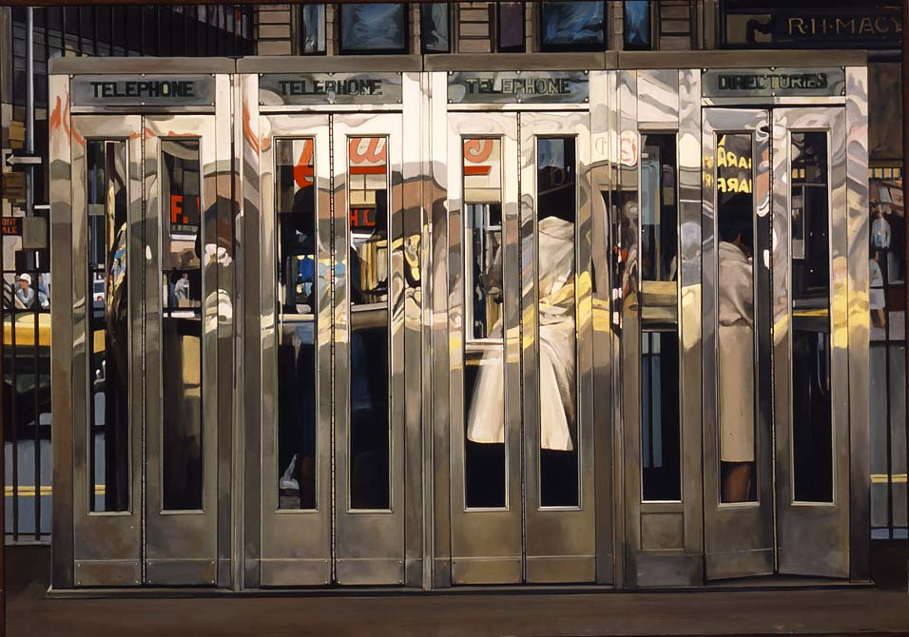
Photo Realism
Richard Estes
Telephone Booths
1968

Slide 19
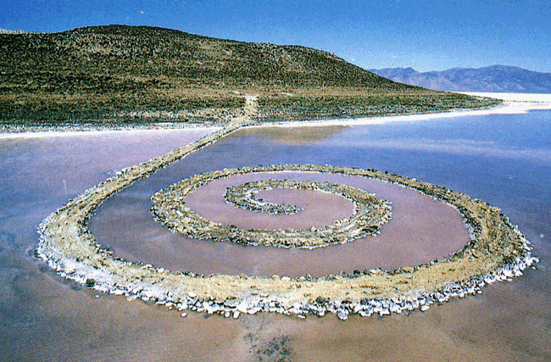
Earth Art
Robert Smithson
Spiral Jetty
1970

Slide 20
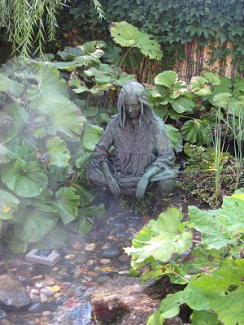
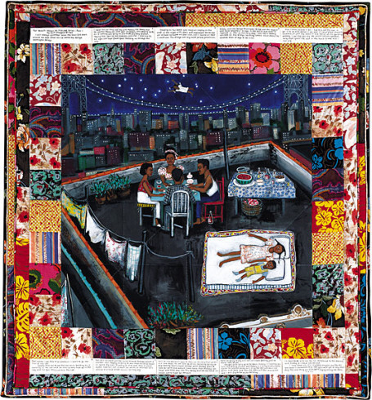
Kiki Smith
Faith Ringgold
Tar Beach
Contemporary Women In Art

